Slide 1
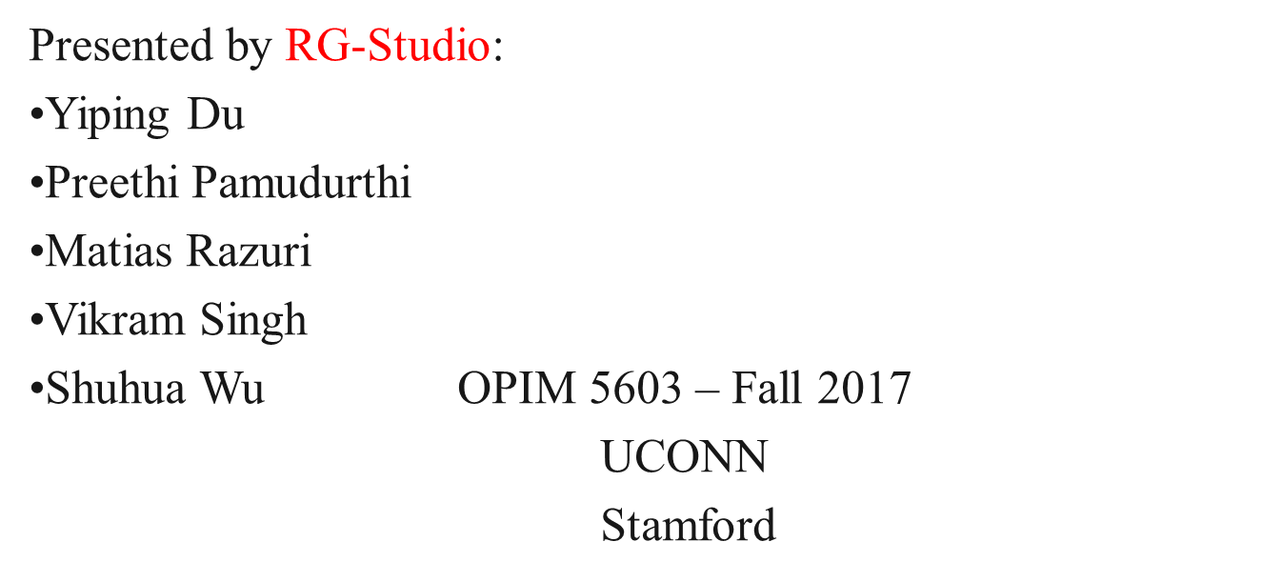
Statistical Analysis of Female Pima Native Americans clinical Data

Slide 2
Introduction
768 Female PIMA Native American patients
8 Diagnostic Measures
  Glucose
  Insulin
  BMI
  Blood Pressure
  Pregnancies
  Age
  Diabetes Pedigree Function
  Skin Thickness
Source: Predict the onset of Type II diabetes based on Diagnostic Measures. (2017, October 9). Retrieved from https://www.kaggle.com/uciml/pima-indians-diabetes-database
Notes:
http://www.mayoclinic.org/diseases-conditions/diabetes/basics/definition/con-20033091

Slide 3
Project Objectives
Data Exploration and Modification
Statistical Testing to unearth data patterns as part of inferential statistics
Develop Models to screen the clinical data to accurately predict female patients with Type II Diabetes.
Notes:
http://www.mayoclinic.org/diseases-conditions/diabetes/basics/definition/con-20033091

Slide 4
At Risk Values
8 Predictor Variables (With Risk values)
  Pregnancies
  Glucose: 2 hrs. Post meal measurements > 140
  Blood Pressure (mm Hg): Diastolic values > 90
  Skin Thickness (mm): skin fold thickness > 16.5
  Insulin (mu U/ml) >166
  BMI >30
  Diabetes Pedigree function
  Age
Source:
Heller, Simon R. (2017). American Diabetes Association, Diabetes Care. International Hypoglycemia Study Group. Retrieved from https://doi.org/10.2337/dc16-2215
National Heart, Lung, and Blood Institute. Types of Hypotension. (2010). Retrieved from https://www.nhlbi.nih.gov/health/health-topics/topics/hyp/types
McDowell, Margaret A., Fryar, Cheryl D., Ogden, Cynthia L., & Flegal, Katherine M. (2003-2006). Anthropometric Reference Data for Children and Adults: United States. Retrieved from https://www.cdc.gov/nchs/data/nhsr/nhsr010.pdf
Buppajarntham, Saranya. (2014, Feb 14). Insulin. Retrieved from https://emedicine.medscape.com/article/2089224-overview
Bays, H. E., Chapman, R. H., & Grandy, S. (2007). The relationship of body mass index to diabetes mellitus, hypertension and dyslipidemia: Comparison of data from two national surveys. International Journal of Clinical Practice, 61(5), 737–747. Retrieved from http://doi.org/10.1111/j.1742-1241.2007.01336.x
Van Tilburg, J. H., Sandkuijl, L. A., Franke, L., Strengman, E., Pearson, P. L., Van Haeften, T. W., and Wijmenga, C. (2003). Genome-wide screen in obese pedigrees with type 2 diabetes mellitus from a defined Dutch population. European Journal of Clinical Investigation, 33: 1070–1074. doi:10.1111/j.1365-2362.2003.01276.x. Retrieved from https://www.cdc.gov/nchs/nhanes/index.htm
Notes:
http://www.mayoclinic.org/diseases-conditions/diabetes/basics/definition/con-20033091

Slide 5
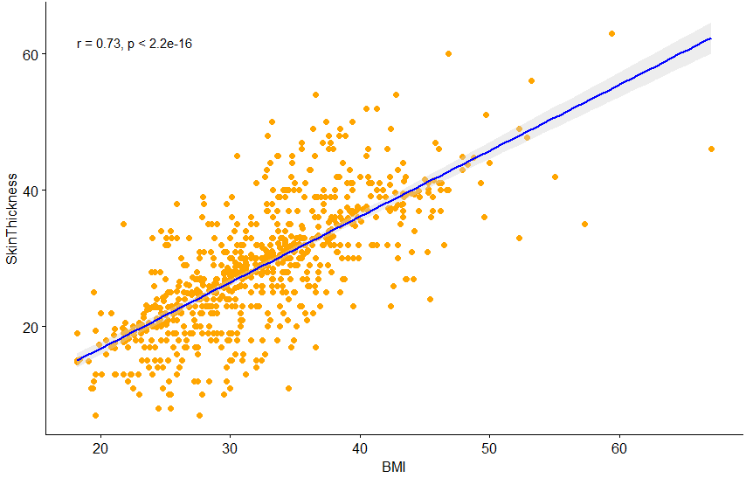
Data Exploration and Modification
  Story 1: Addressing Missing Values
  K-Nearest Neighbors Clustering
  Story 2: Correlation between BMI and Skin Thickness
        Parametric test to check the hypothesis that there is no correlation between BMI & SkinThickness – pvalue is 0.02
Source: Semiz, S., Ozgoren. E., & Sabir. N. (2006, June 20). Comparison of ultra-sonographic and anthropometric methods to assess body fat in obesity. Retrieved from https://www.nature.com/articles/0803414
Notes:
http://www.mayoclinic.org/diseases-conditions/diabetes/basics/definition/con-20033091

Slide 6
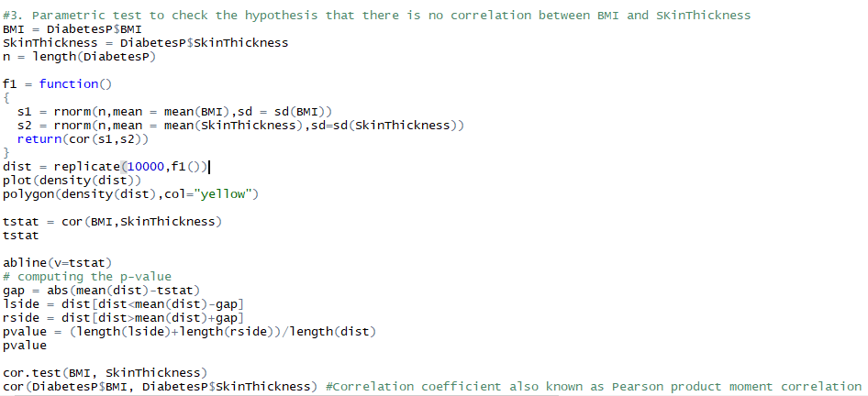
Data Exploration and Modification
  Story 2: Correlation between BMI and Skin Thickness
        Parametric test to check the hypothesis that there is no correlation between BMI & SkinThickness – pvalue is 0.02
Source: Semiz, S., Ozgoren. E., & Sabir. N. (2006, June 20). Comparison of ultra-sonographic and anthropometric methods to assess body fat in obesity. Retrieved from https://www.nature.com/articles/0803414
Notes:
http://www.mayoclinic.org/diseases-conditions/diabetes/basics/definition/con-20033091

Slide 7
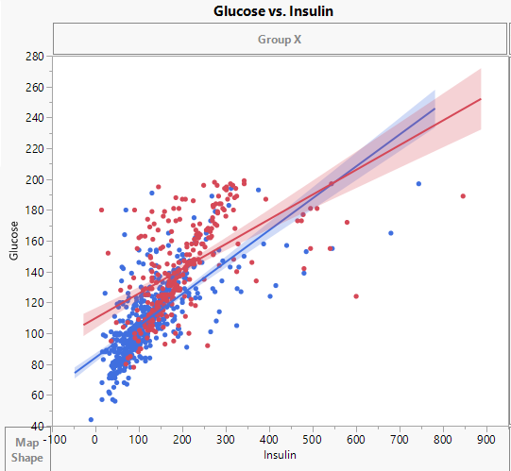
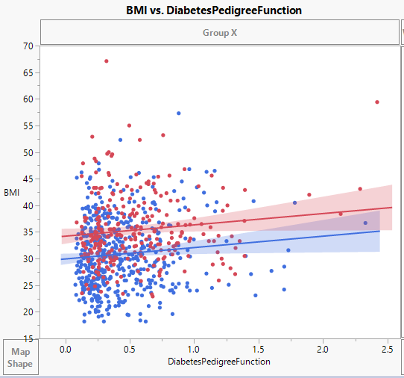
Data Exploration and Modification
Story 3: Strong Predictors Vs All Predictors
Story 4: Interaction Terms: Nonparametric test to check that this interaction has no impact on the outcome
Glucose x Insulin
BMI x DiabetesPedigreeFunction:
Source: Hu, Hao., Huff, Chad D., Yamamura, Yuko., Wu, Xifeng., Strom, Sara S. (2015). The Relationship Between Native American Ancestry, Body Mass Index and Diabetes Risk among Mexican-Americans. Retrieved from http://journals.plos.org/plosone/article?id=10.1371/journal.pone.0141260

Slide 8
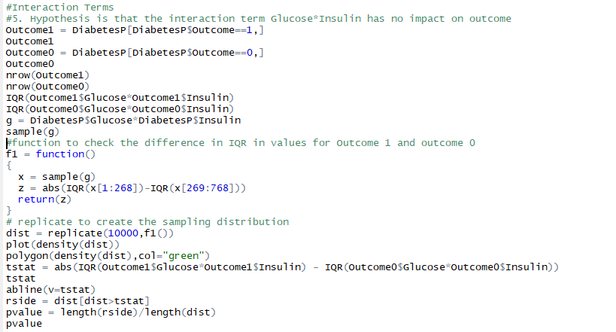
Data Exploration and Modification
Story 4: Interaction Terms: Nonparametric test to check that this interaction has no impact on the outcome
Glucose x Insulin
BMI x DiabetesPedigreeFunction:
Source: Hu, Hao., Huff, Chad D., Yamamura, Yuko., Wu, Xifeng., Strom, Sara S. (2015). The Relationship Between Native American Ancestry, Body Mass Index and Diabetes Risk among Mexican-Americans. Retrieved from http://journals.plos.org/plosone/article?id=10.1371/journal.pone.0141260

Slide 9

Visualization
For Visualization purpose of our Project we used the package “ggplot2”.
We used “Boxplot Graph” to determine the effect of each variable on Outcome: Also, performed nonparametric tests for modifiable risk factors using IQR as test statistic

Slide 10
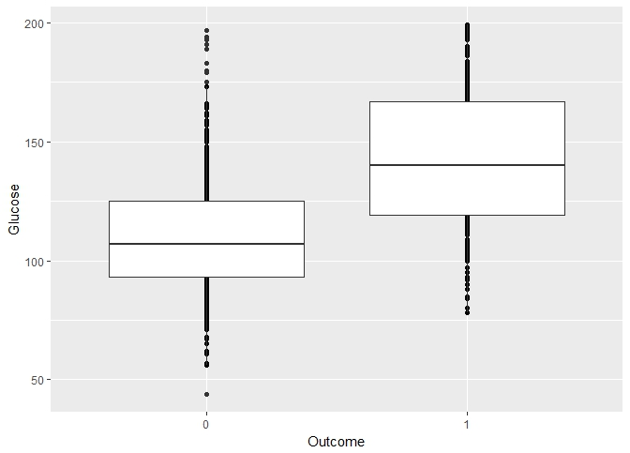
Visualization

Slide 11
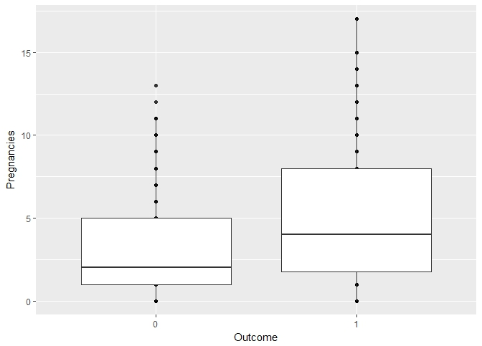
Visualization

Slide 12
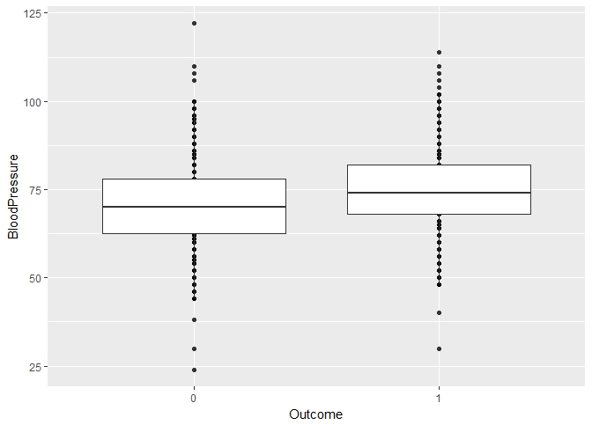
Visualization

Slide 13
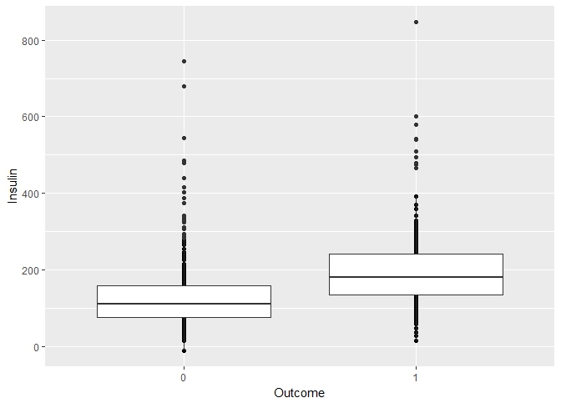
Visualization

Slide 14
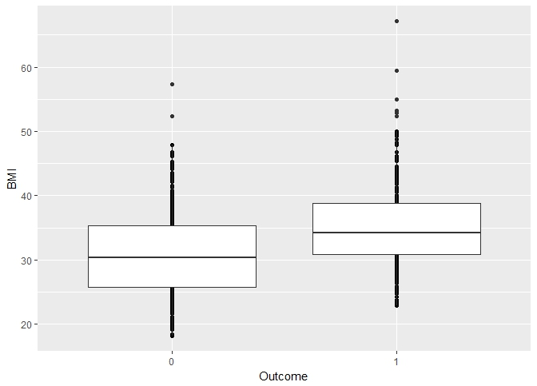
Visualization

Slide 15
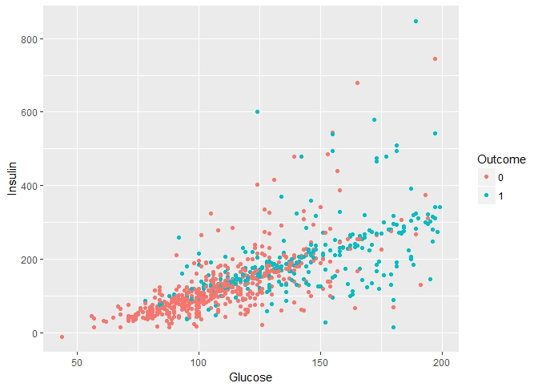
Visualization

Slide 16
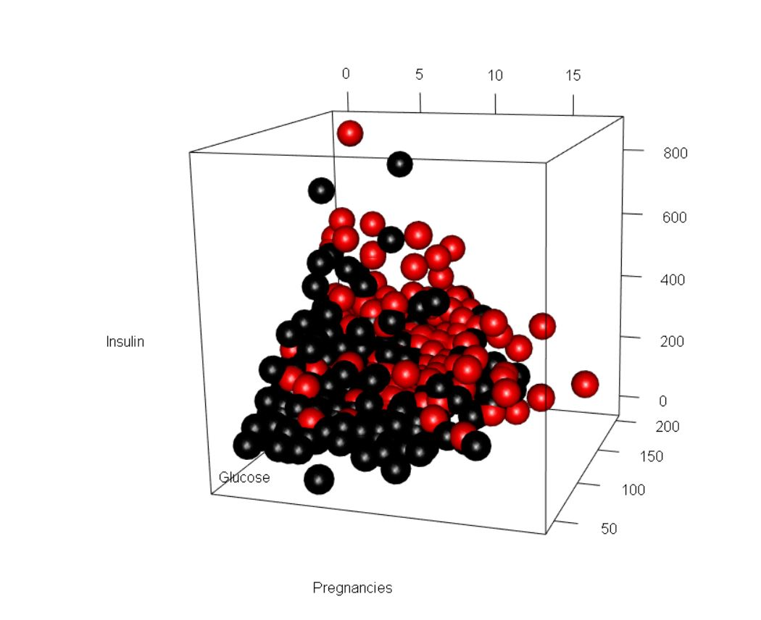
Visualization

Slide 17
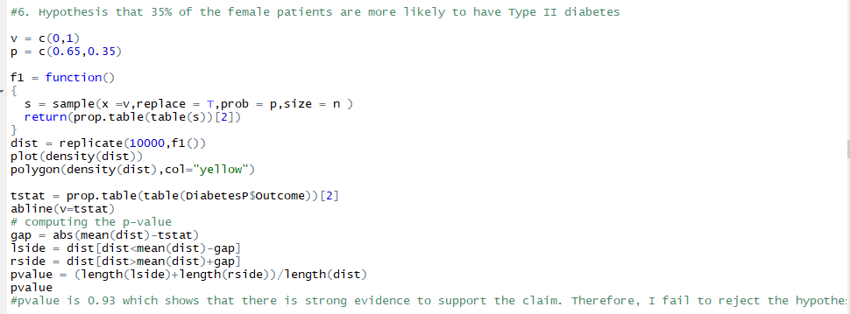
Statistical testing
Story 5: Hypothesis is 35% of female Pima patients have Type II Diabetes
Source: Hu, Hao., Huff, Chad D., Yamamura, Yuko., Wu, Xifeng., Strom, Sara S. (2015). The Relationship Between Native American Ancestry, Body Mass Index and Diabetes Risk among Mexican-Americans. Retrieved from http://journals.plos.org/plosone/article?id=10.1371/journal.pone.0141260
Knowler, William C., Bennett, Peter H., Hamman, Richard. F., Miller, Max. (1978). Diabetes Incidence and Prevalence in Pima Indians: A 19 Fold Greater Incidence Than In Rochester, MN.

Slide 18
Maximum Likelihood
  Pregnancies (a1)
  Glucose (a2)
  Blood Pressure (a3)
  BMI (a4)
  Diabetes Pedigree Function (a5)
  Age (a6)
  Insulin (a7)
Which predictors have the most impact on diagnosing Type II diabetes?
Notes:
http://www.mayoclinic.org/diseases-conditions/diabetes/basics/definition/con-20033091

Slide 19
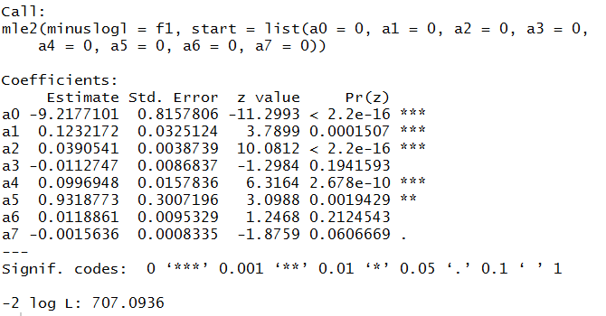
Maximum Likelihood
Source: Hu, Hao., Huff, Chad D., Yamamura, Yuko., Wu, Xifeng., Strom, Sara S. (2015). The Relationship Between Native American Ancestry, Body Mass Index and Diabetes Risk among Mexican-Americans. Retrieved from http://journals.plos.org/plosone/article?id=10.1371/journal.pone.0141260
Notes:
http://www.mayoclinic.org/diseases-conditions/diabetes/basics/definition/con-20033091

Slide 20
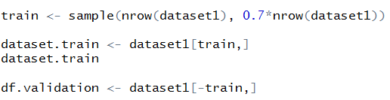
Logistic Regression Model
Partition
Training:
70%
Validation:
30%

Slide 21
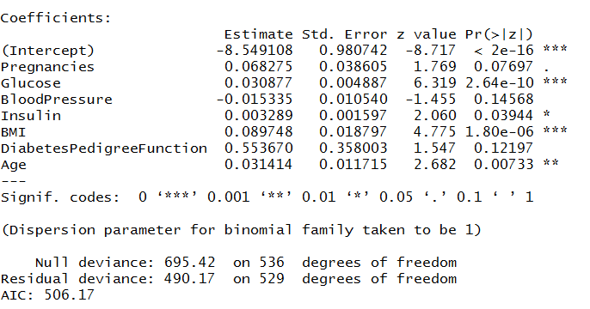
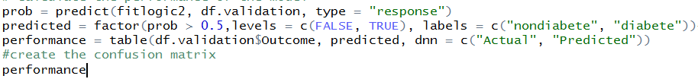

Regression 1
X = -8.55 + 0.068*pregnancies + 0.03*glucose - 0.0015*bloodpressure + 0.003*Insulin +0.09*BMI+ 0.55*diabetes pedigree function - 0.03*age
AIC: 511.72
Total Accuracy: 79.7%
Accuracy of 1: 79%

Slide 22
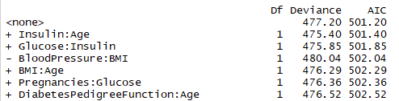


Regression 2
reg2 = glm(Outcome ~. + Glucose:Insulin, data = dataset.train,family = binomial())
AIC: 509.13
Total Accuracy: 78%
Accuracy of 1s: 76%

Slide 23
Conclusion
Modifiable risk factors: Glucose, Insulin and BMI
Non Modifiable Risk factors: Pregnancies, Age & Diabetes Pedigree function
Our analysis and model delivers value by predicting asymptomatic patients who have diabetes

Slide 24
Thank You!

